Slide 1
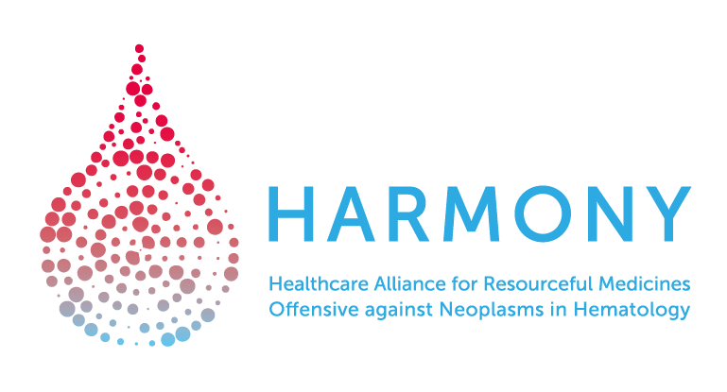
European Network of Excellence for Big Data in Hematology, consisting of 53 partners from 11 countries.
HARMONY Platform: using Big Data to fight blood cancers
María Abáigar Alvarado¹, Renate Schulze-Rath², Ana Eugenia Rodríguez-Vicente¹, Santiago Moralejo-del-Arco¹, Aliki Taylor¹, Lars Bullinger⁵
¹Group of Molecular Genetics in Oncohematology - Institute of Biomedical Research of Salamanca (IBSAL), Cancer Research Center - University of Salamanca (USAL-CSIC), Spain; ²Bayer, Germany; ³Institute of Biomedical Research of Salamanca (IBSAL), Spain; ⁴Takeda, United Kingdom; ⁵Charité – Universitätmedizin Berlin, Germany
22 & 23 October 2018 • IMI Scientific Symposium • Brussels, Belgium

Slide 2
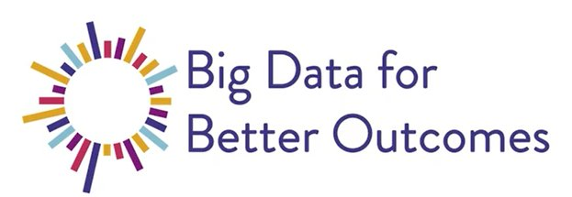
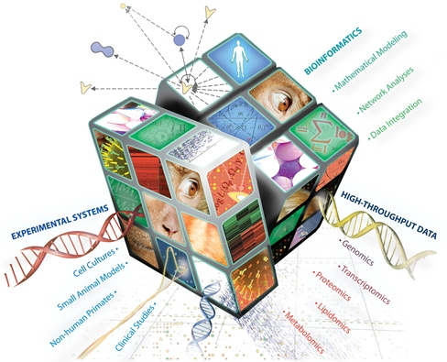
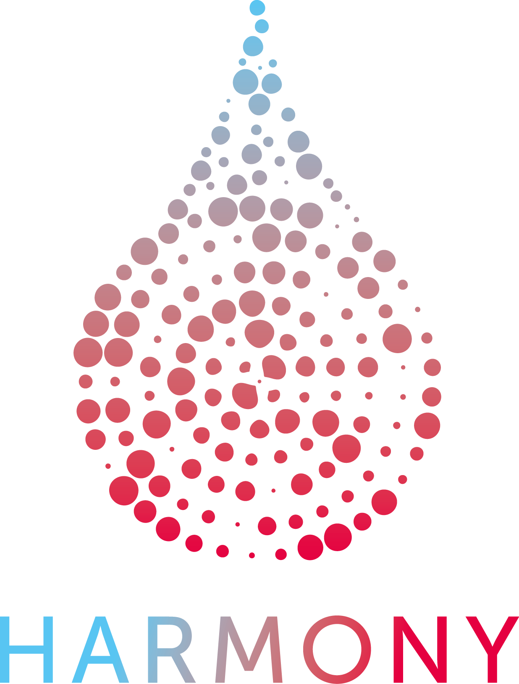

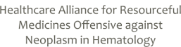
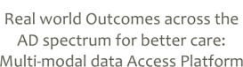
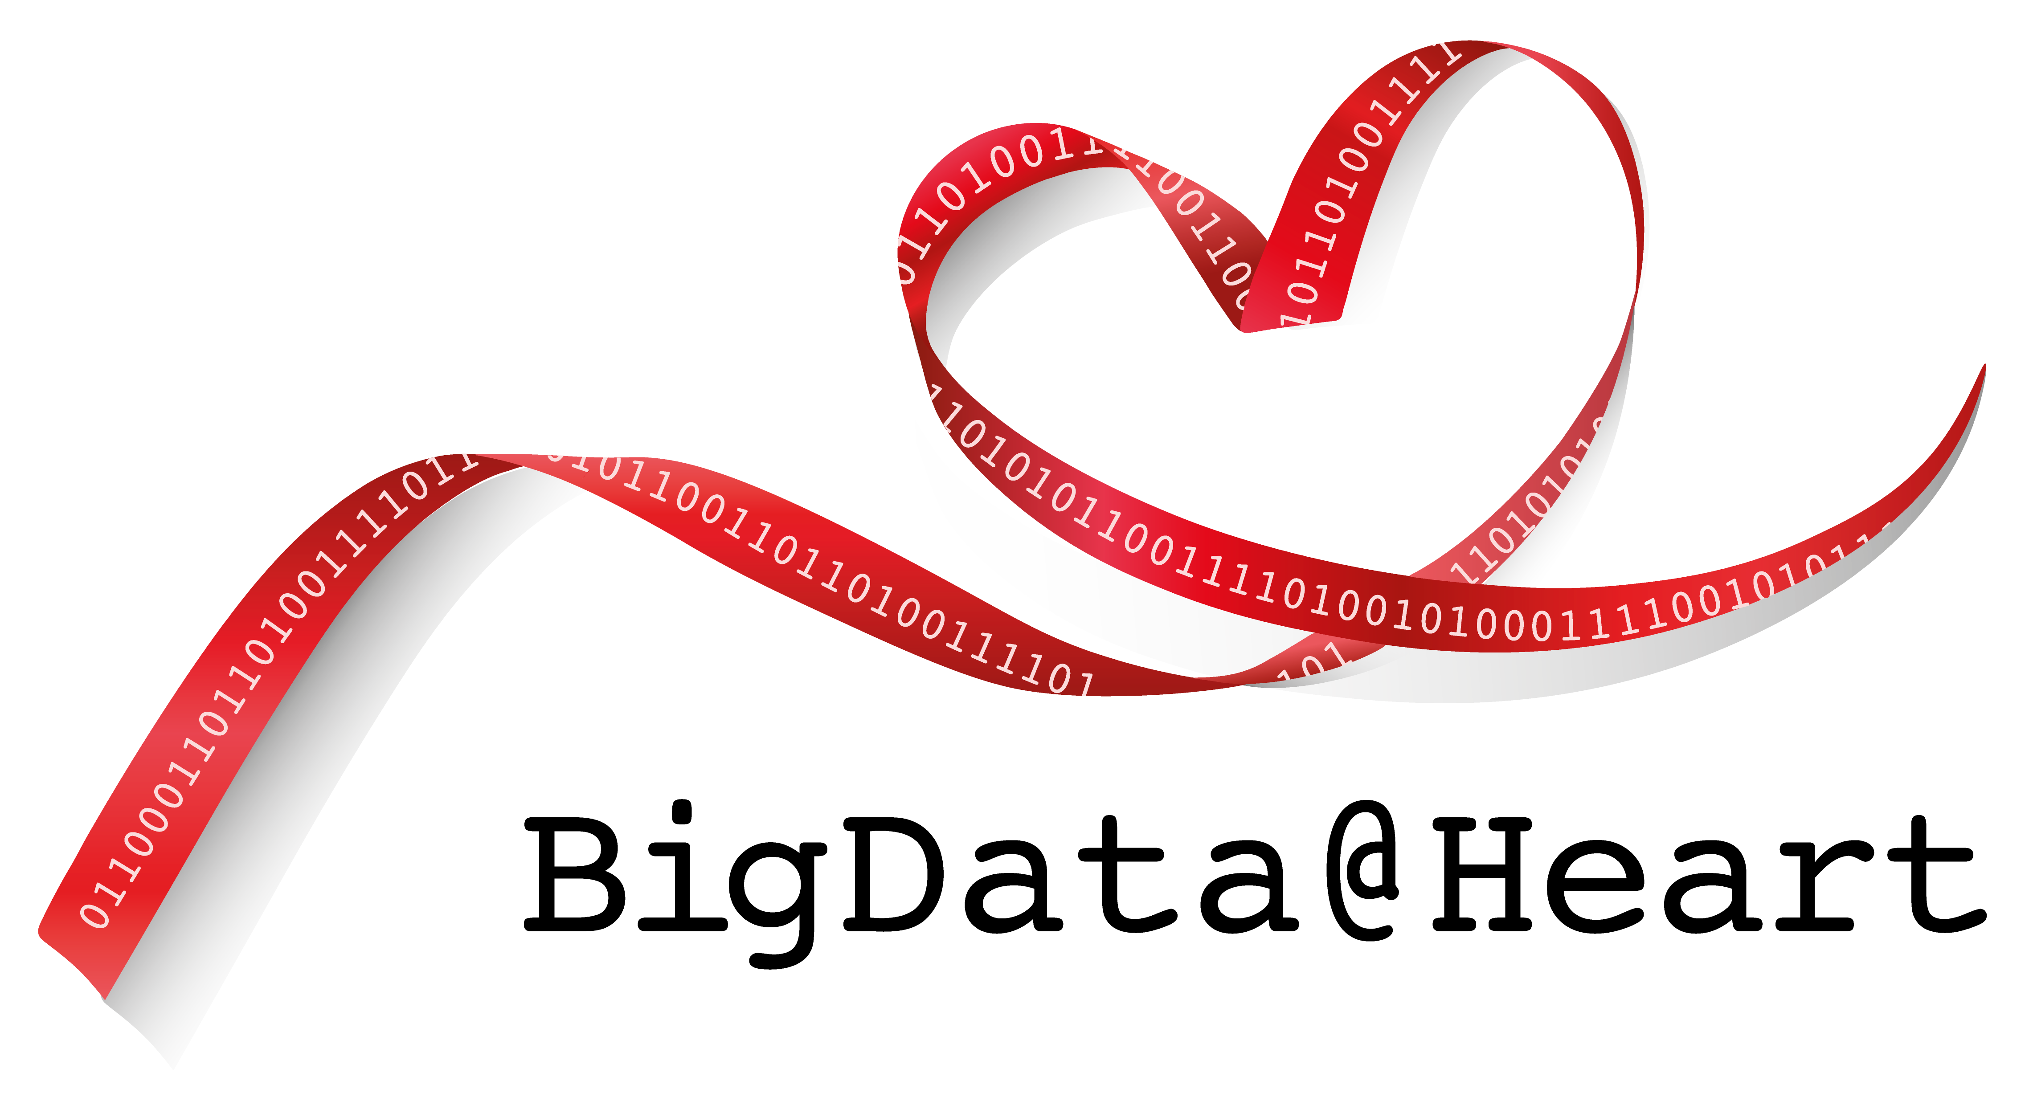


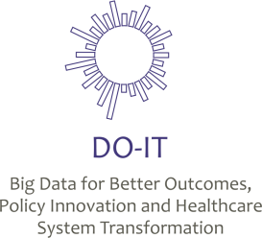

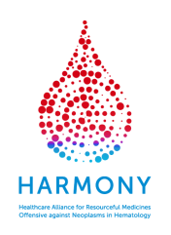
Biggest IMI project in BD4BO for Blood Cancers

Slide 3


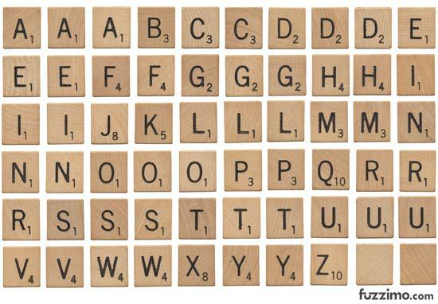
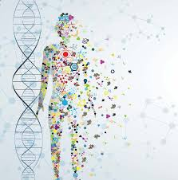
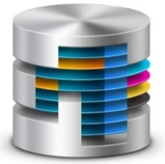
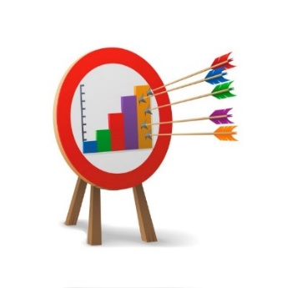

High quality Platform
4
Translating omics data into clinical practice
Outcomes harmonization
Speed up drug development & access to novel therapies
HARMONY: from data to patients
HARMONY: from data to patients

Slide 4
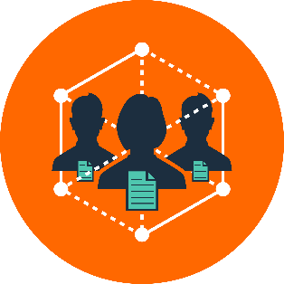
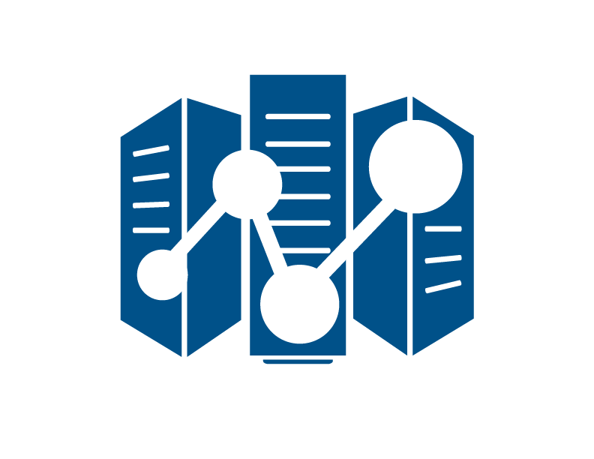





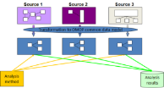


Studies
Research questions
Data Lake
~70,000
data
Data Provider
Trusted Third Party
HARMONY Platform
Access restrictions
Data preparation
Data brokerage
Data intake & storage
Harmonization
Analysis
de-facto
anonymization
(GDPR)
ID code change
CNAF
OMOP
HARMONY platform is set up & running

Slide 5

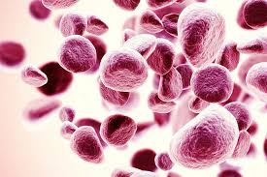
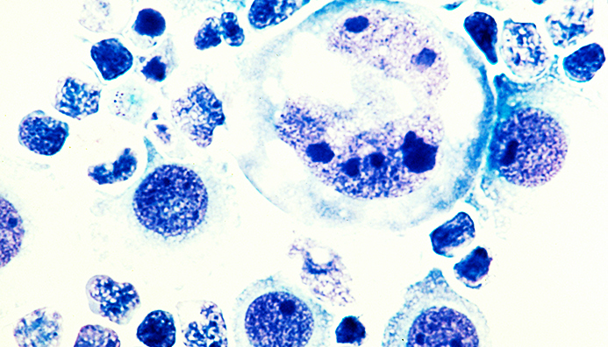

Leukemia
Myeloma
Lymphoma
P - 45
Ongoing & upcoming studies

